Slide 1
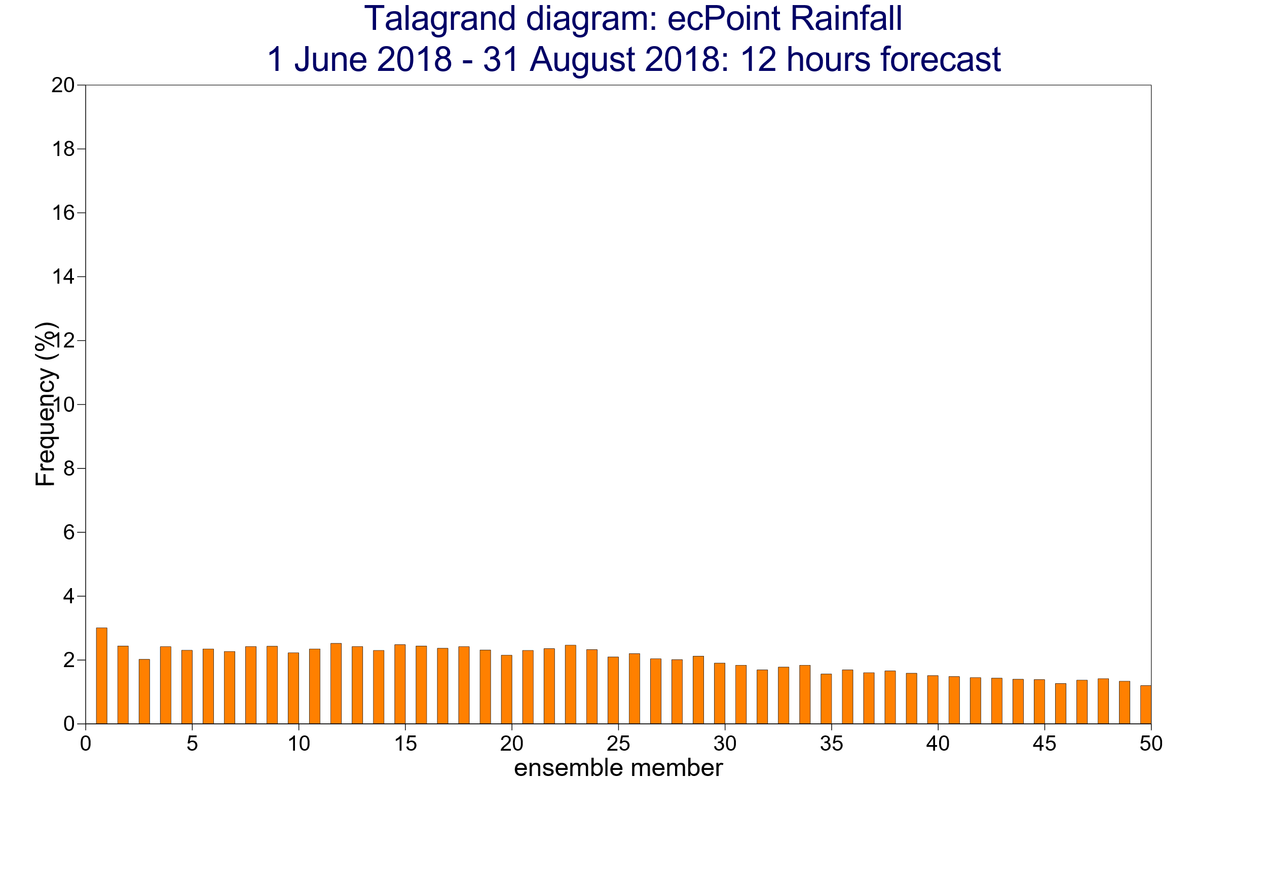
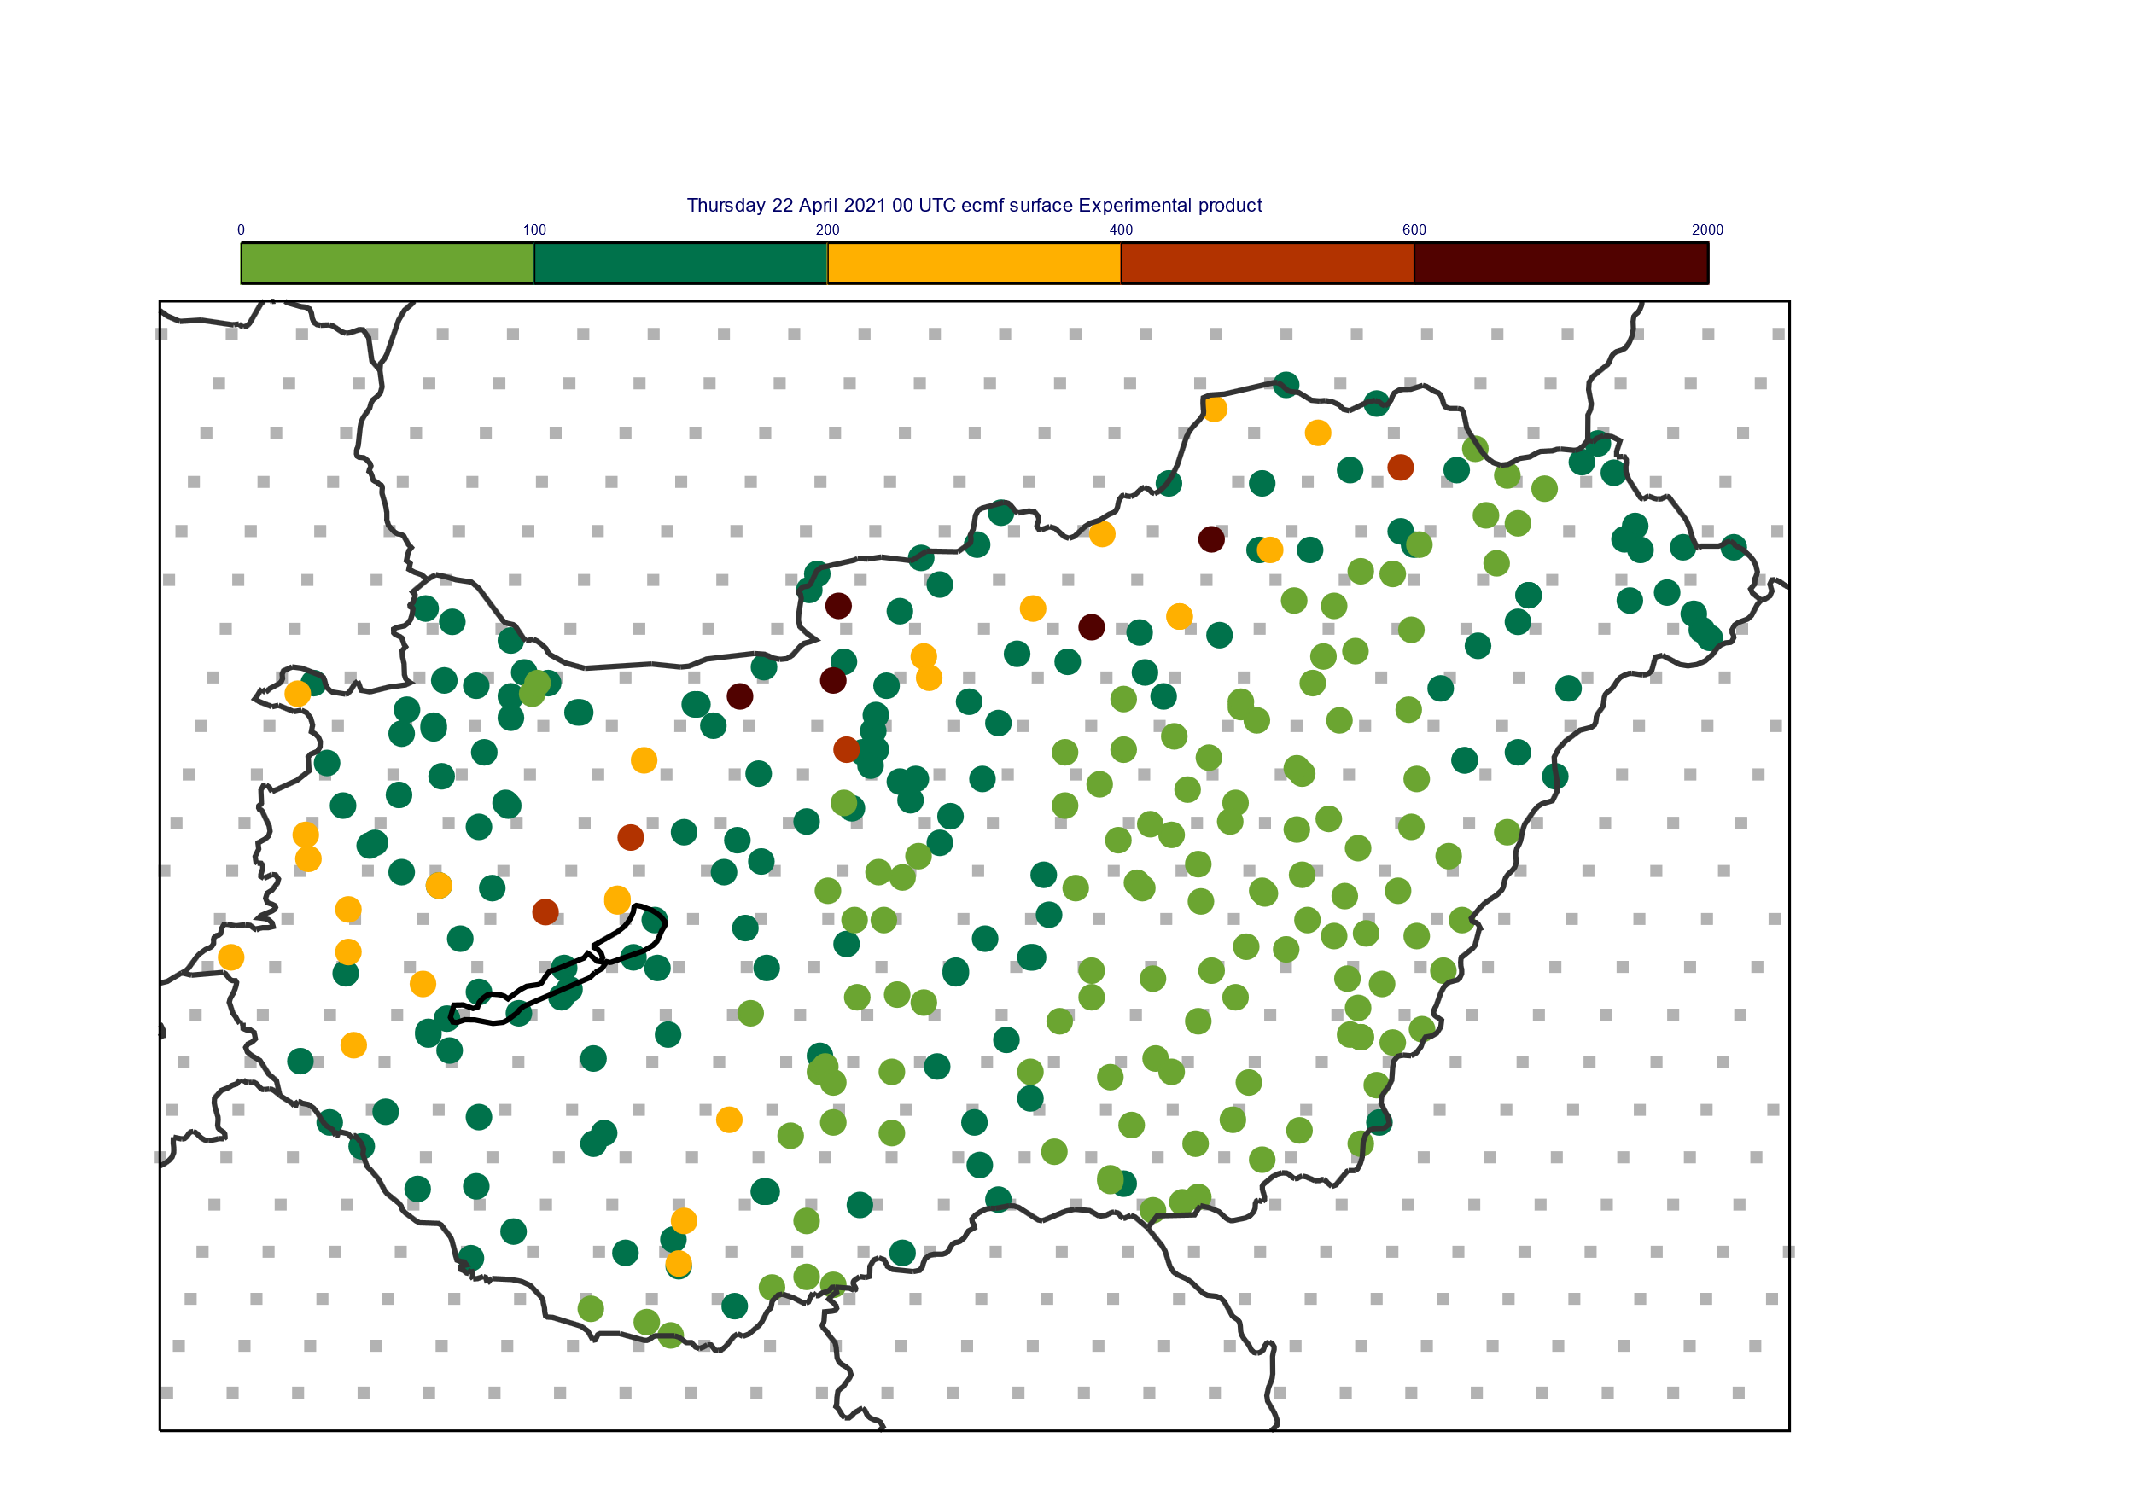
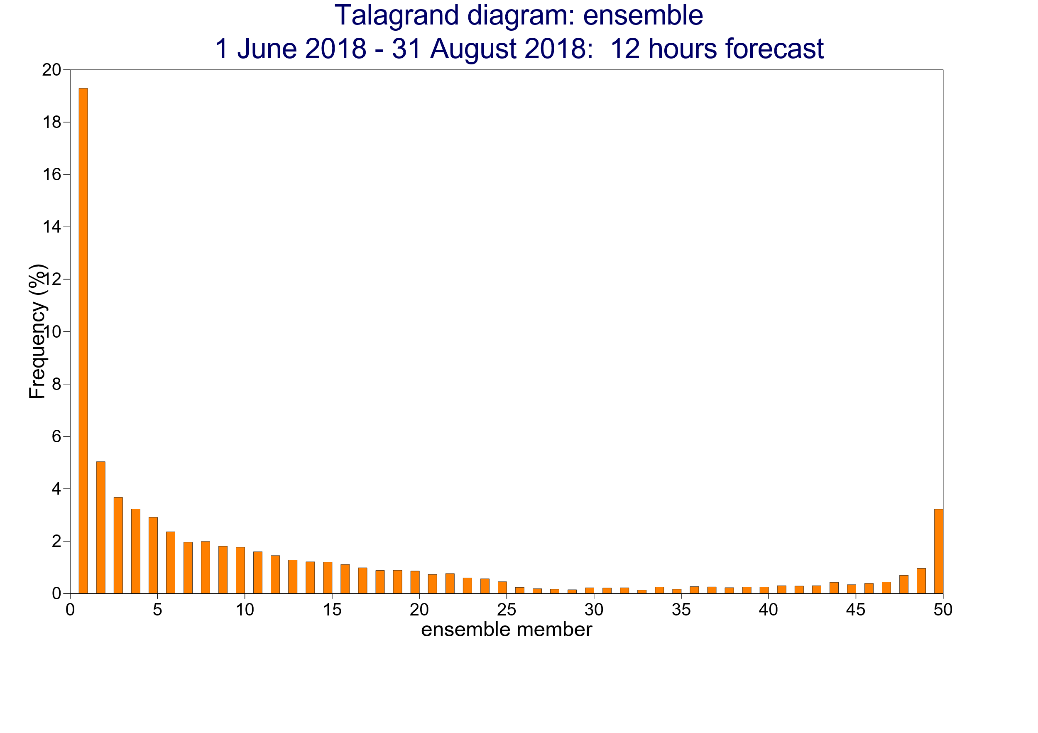
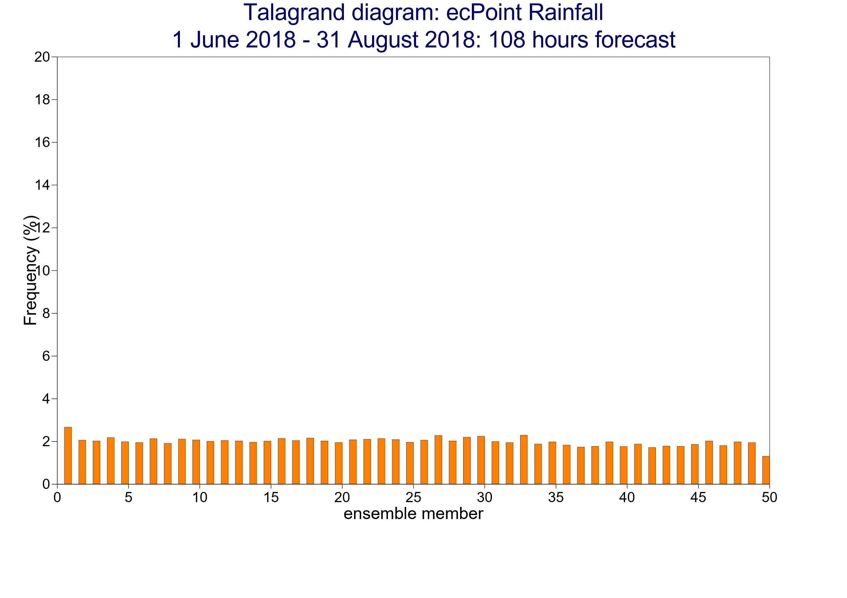
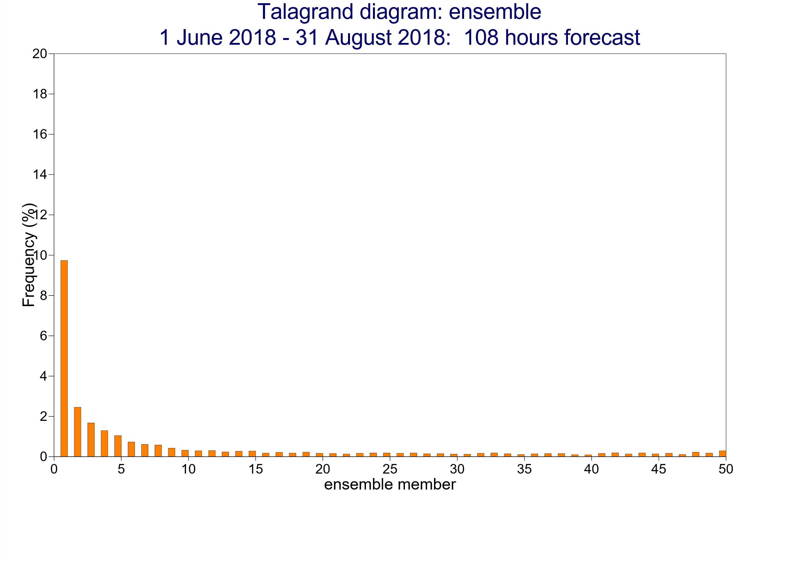
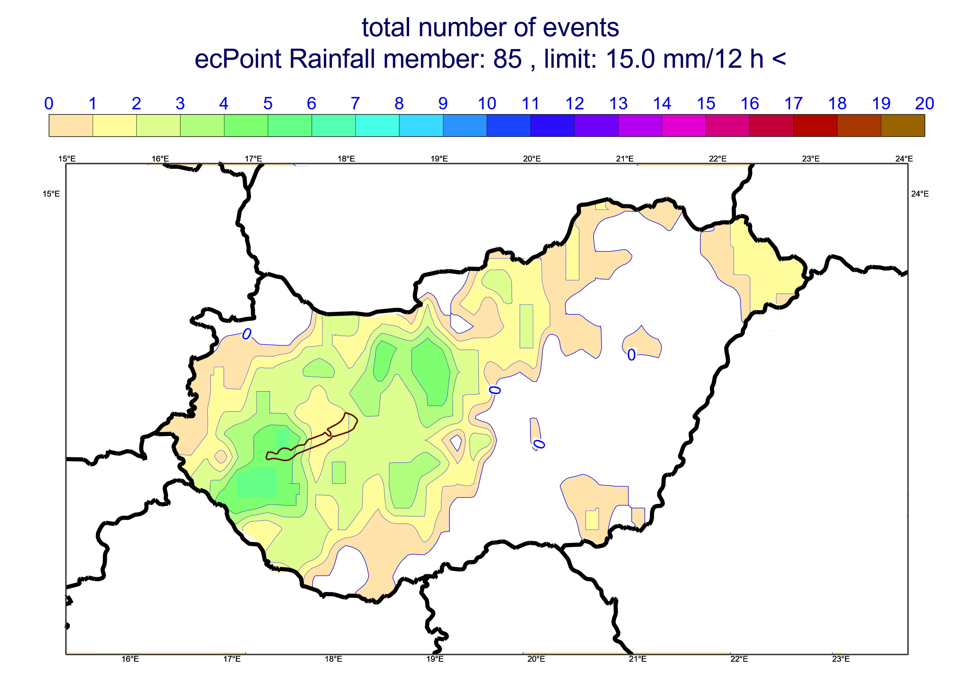
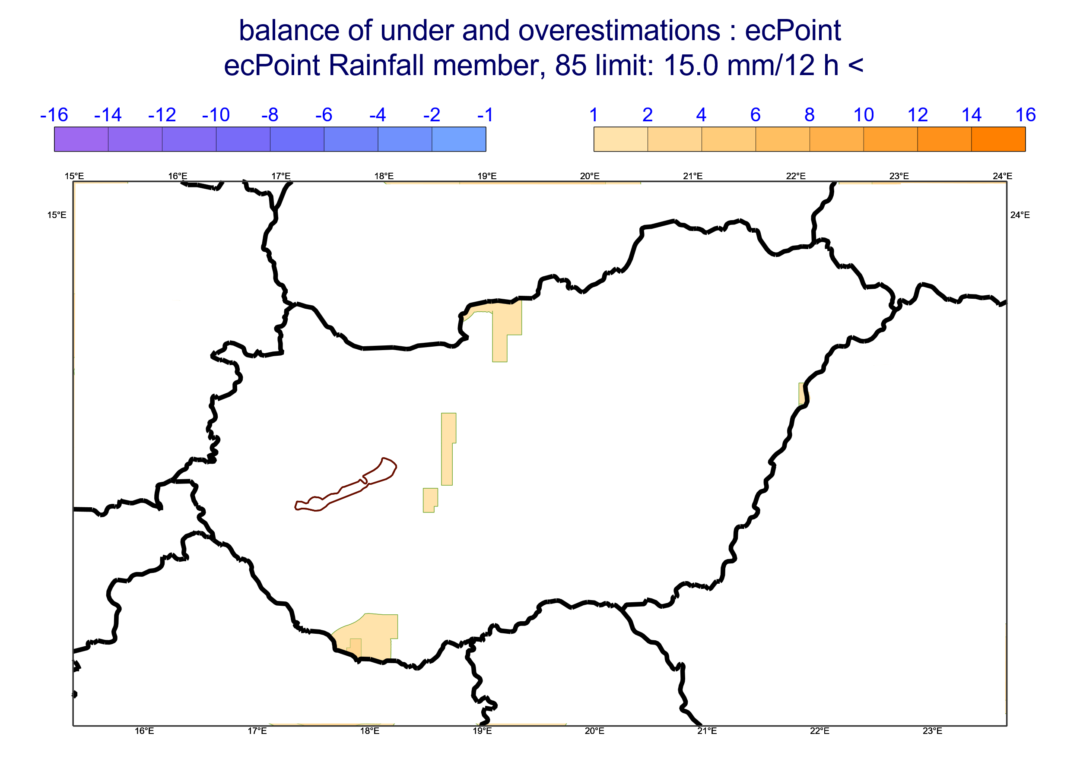
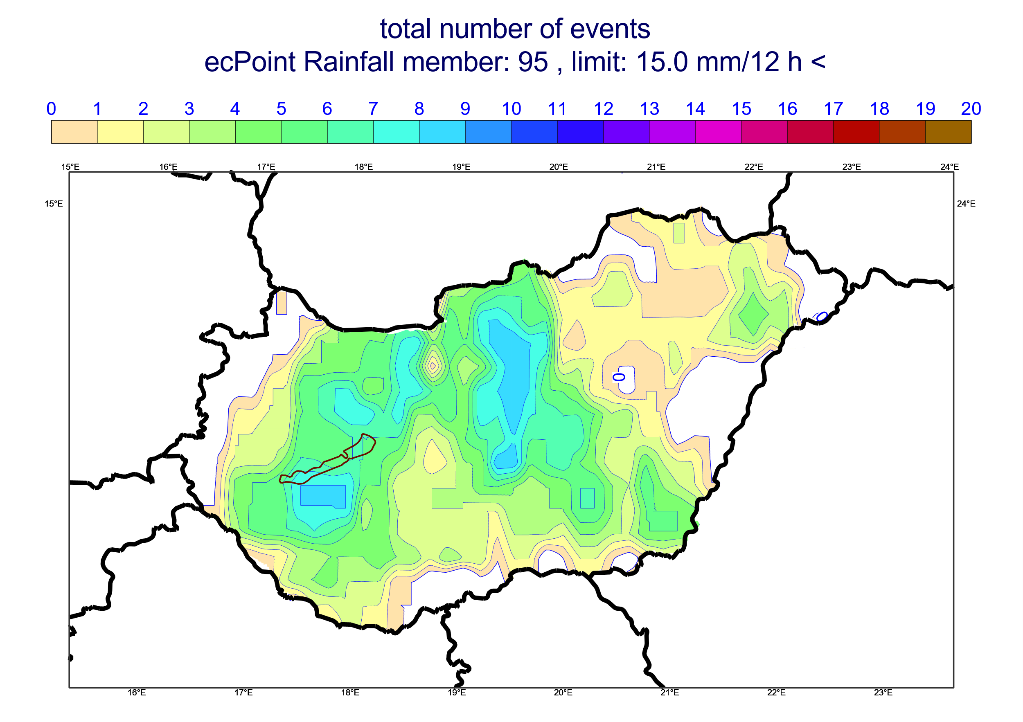
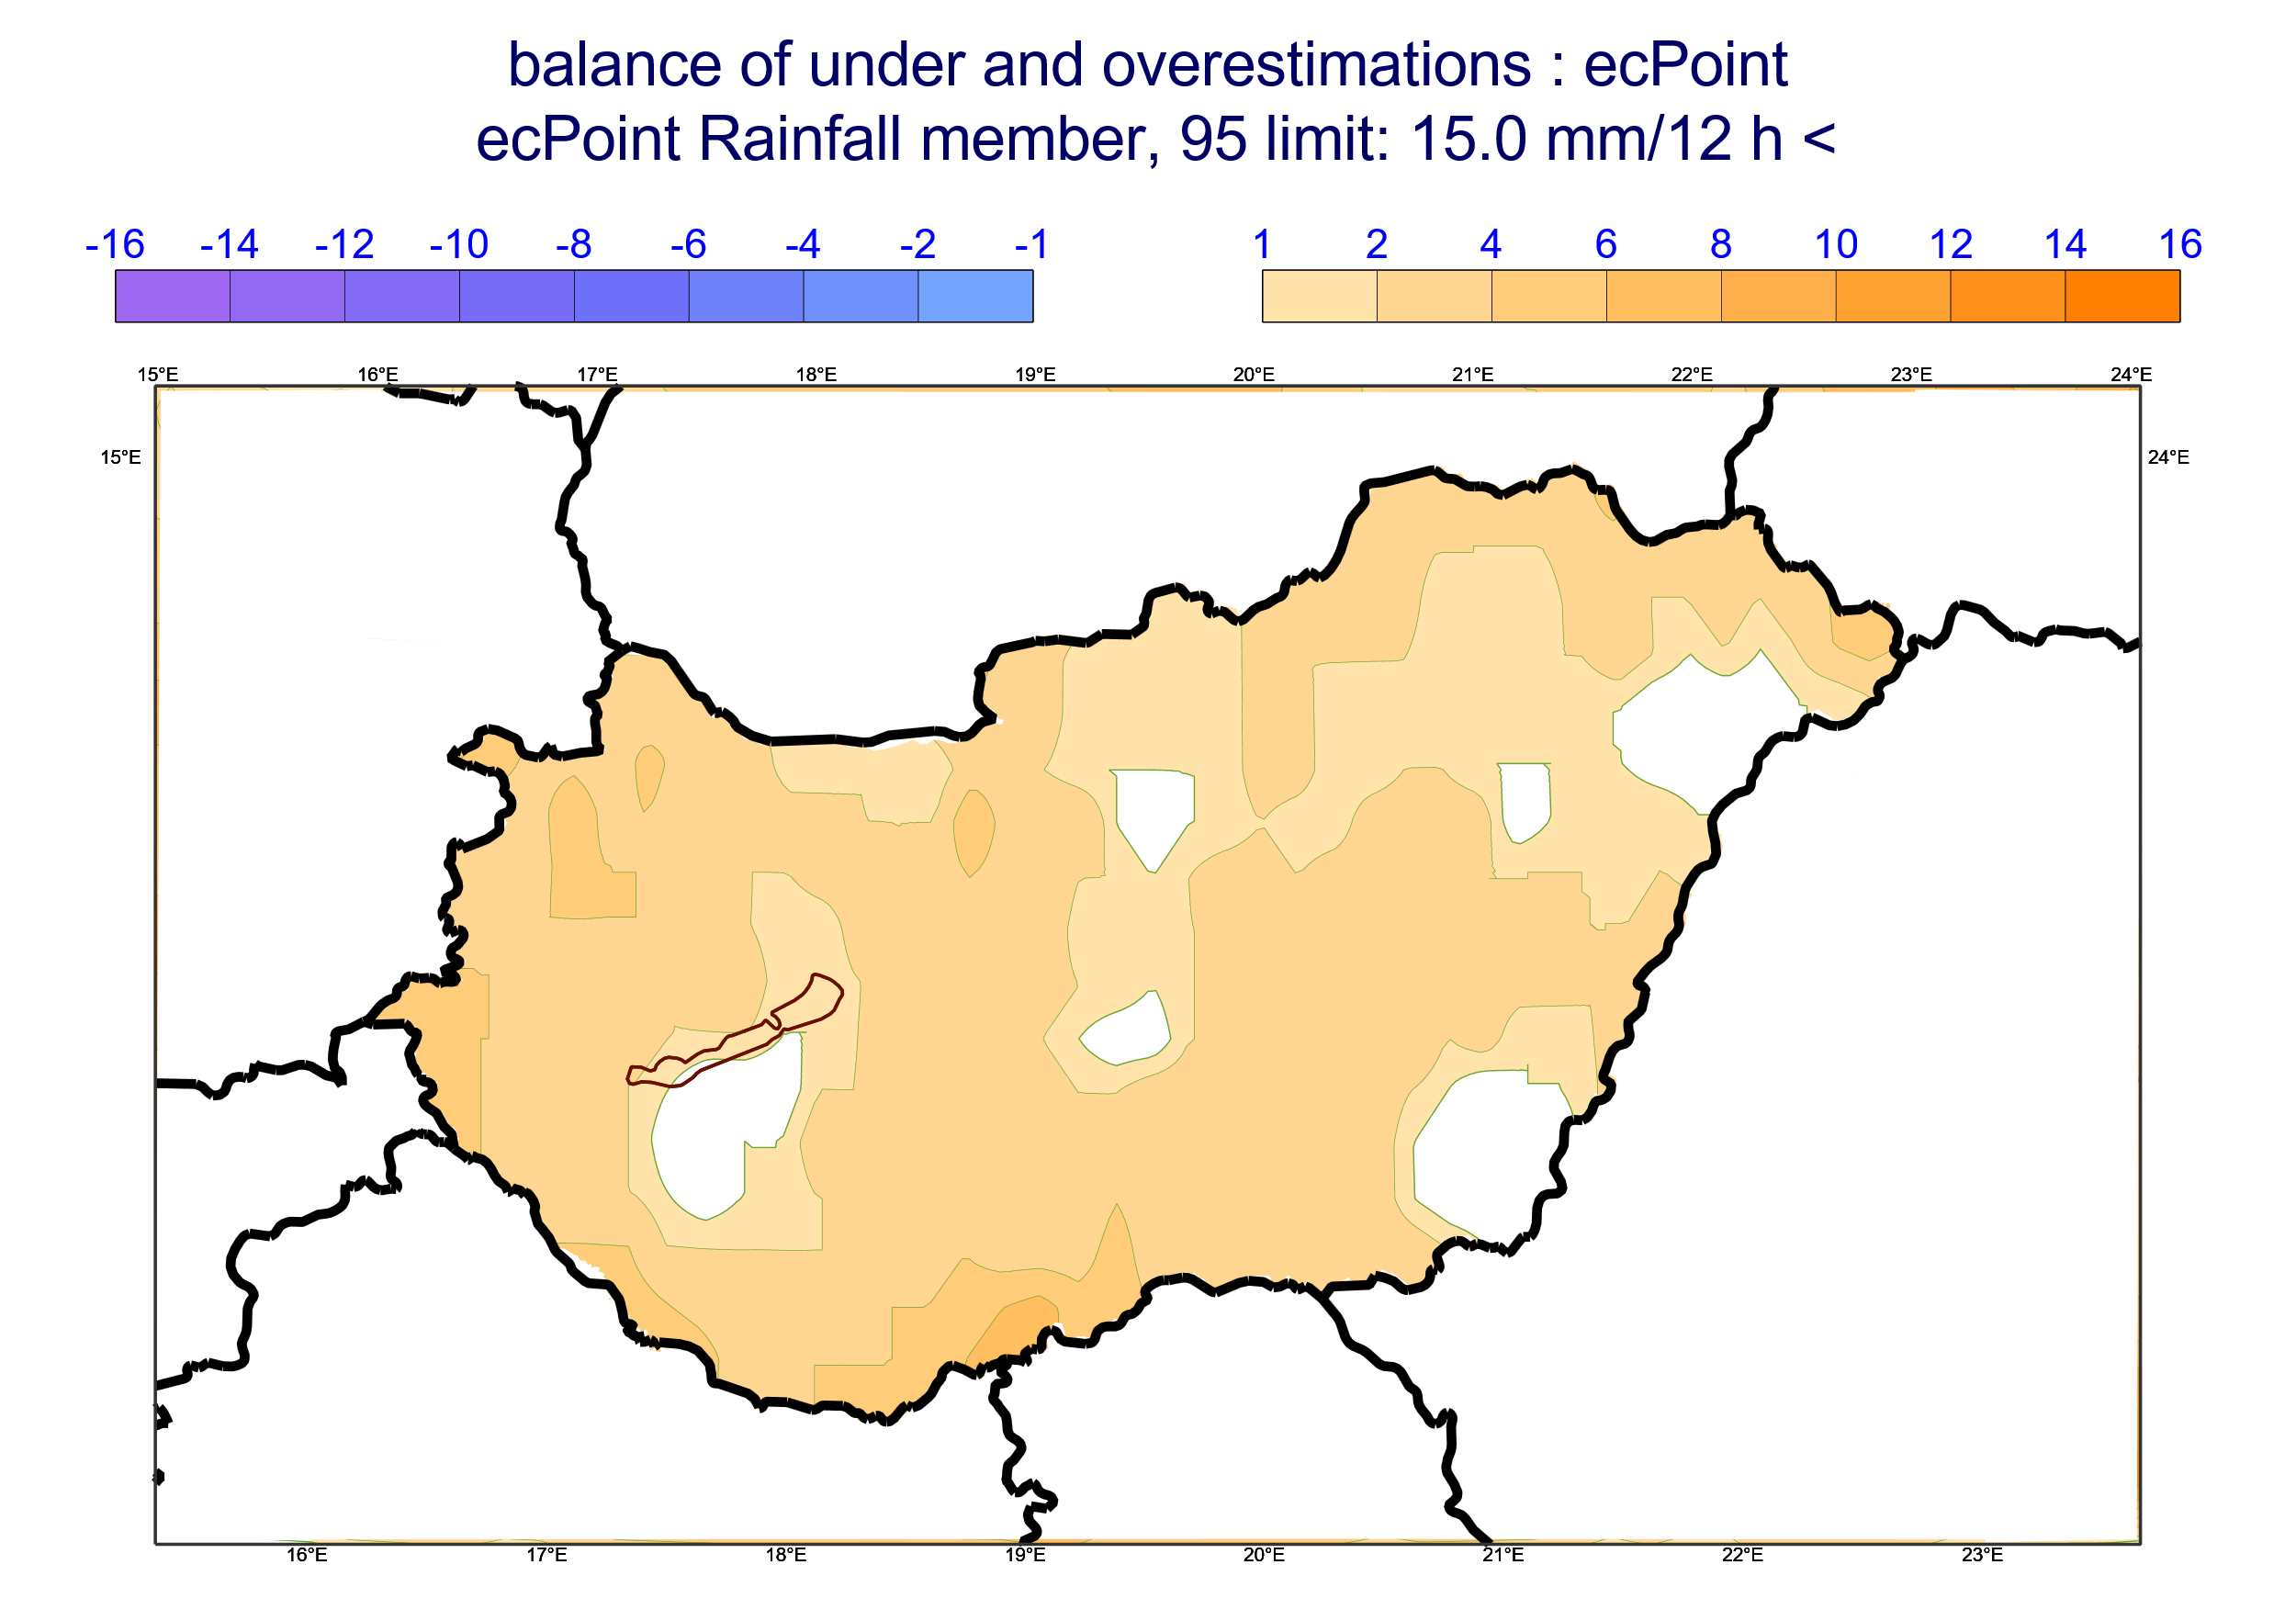
Location of rain gauges relative to ecPoint-Rainfall and Raw ECMWF ENS grid-points
a)
Talagrand diagrams
b)
20
Rain Gauge
18
ecPoint-Rainfall
(t+0,t+12)
ECMWF ENS
(t+0,t+12)
16
Grid-Box Centre
14
12
Probability of Occurrence (%)
10
8
6
4
Perfectly reliable forecasts
Perfectly reliable forecasts
2
0
20
18
ecPoint-Rainfall
(t+96,t+108)
ECMWF ENS
(t+96,t+108)
16
14
12
Probability of Occurrence (%)
10
8
6
4
Perfectly reliable forecasts
Perfectly reliable forecasts
2
Rain gauges height [m a.s.l.]
0
1
10
20
30
40
50
60
70
80
90
99
1
< 100
100 - 200
200 - 400
400 - 600
> 600
Ensemble Members
5
10
15
20
25
30
35
40
45
51
Ensemble Members
Number of days with overall good performance for ecPoint-Rainfall
(i.e. with no overall rainfall under- or overestimation)
Number of days with overall rainfall under- and
overestimation for ecPoint-Rainfall
No
Obs
Overall
under-/overest.
Overall good performance
No
Obs
No overall
under-/overest.
Overall Underest.
Overall Overest.
0
1
2
3
4
5
-5
-4
-3
-2
-1
1
2
3
4
5
6
7
8
9
10
c)
d)
(t+0,t+12), 85th Percentile & tp >= 15 mm/12h
(t+0,t+12), 95th Percentile & tp >= 15 mm/12h

